Slide 1

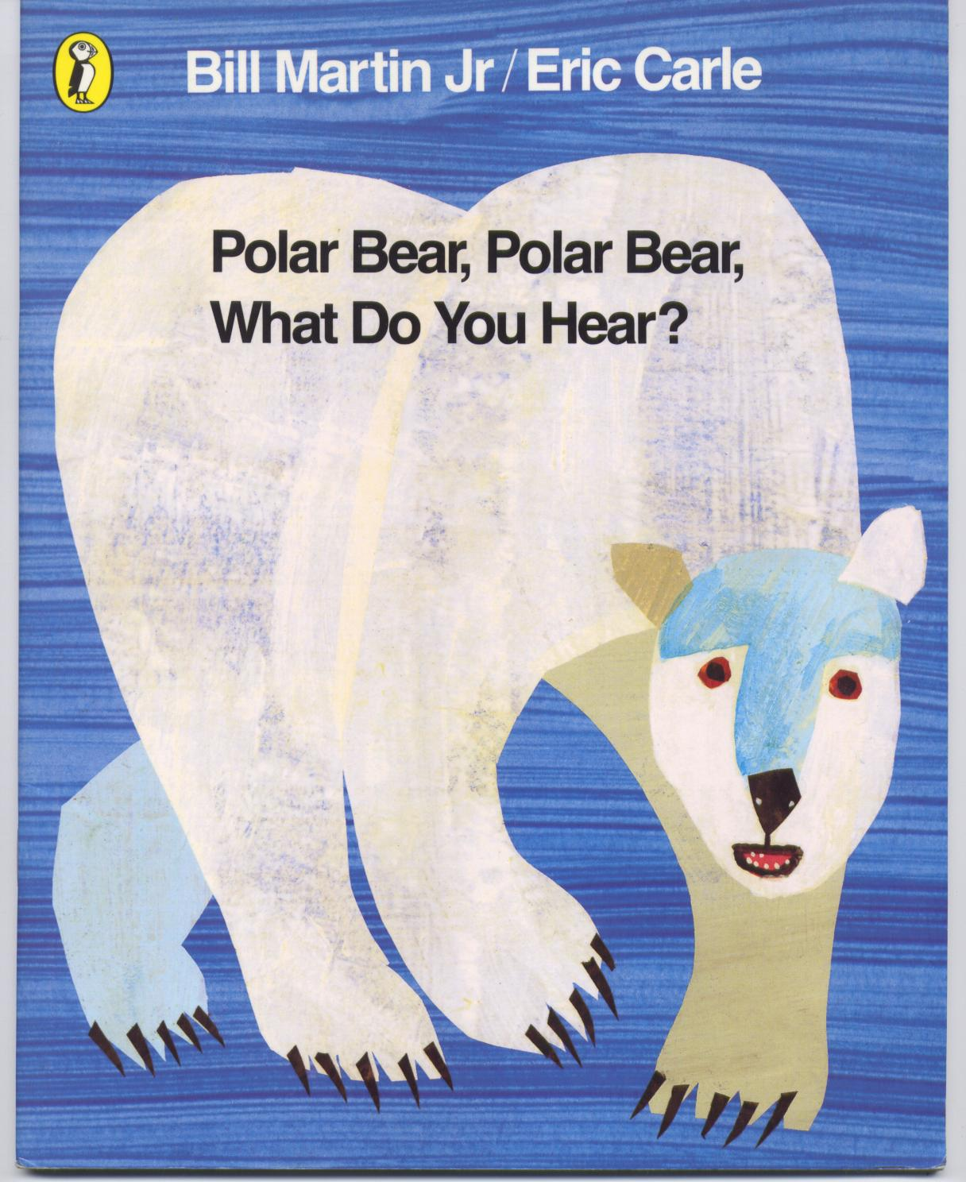
Polar bear, polar bear, what do you see?
Eric Carle

Slide 2
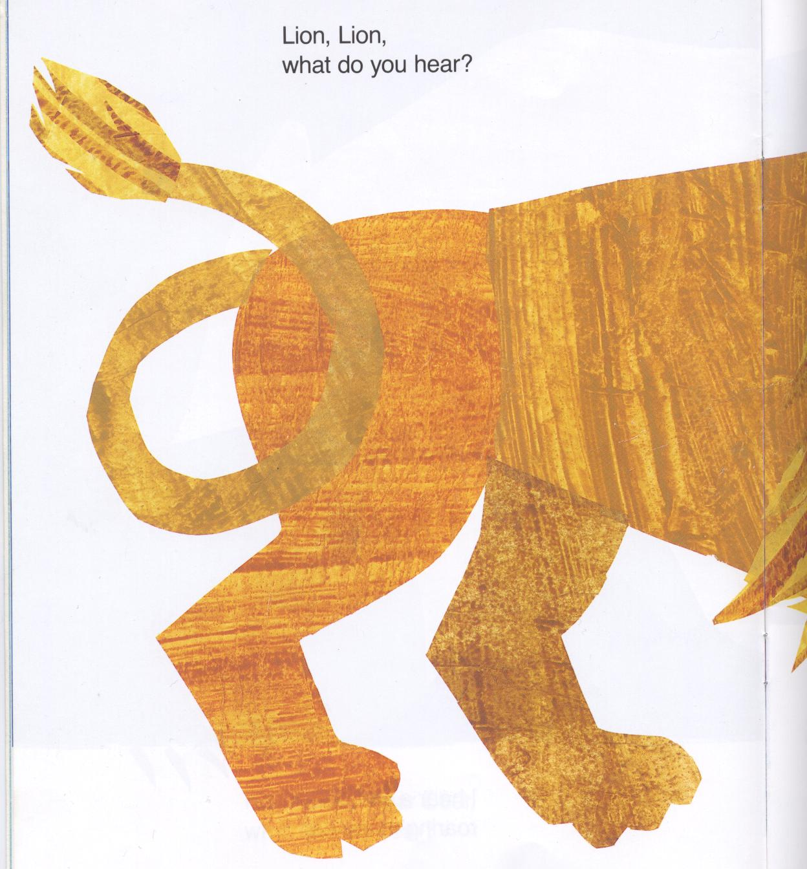
Lion, lion,
What do you hear?

Slide 3
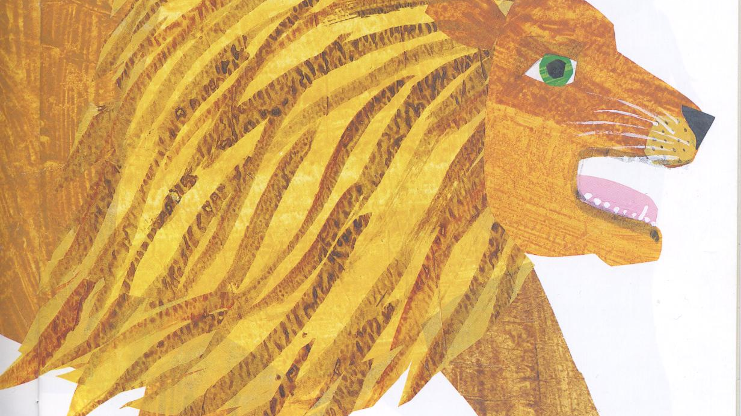

Slide 4
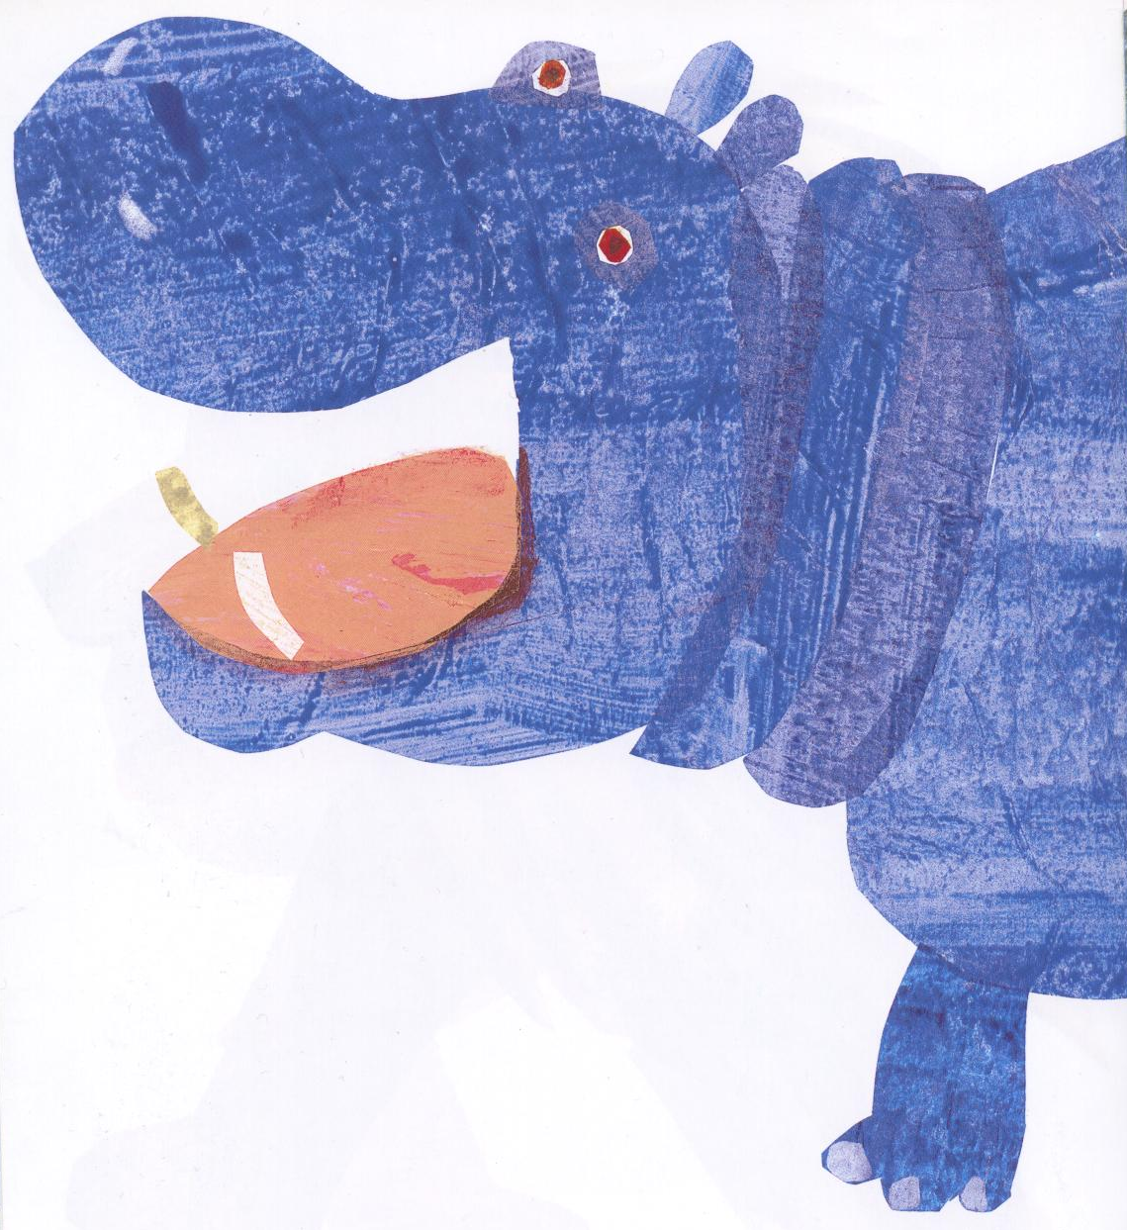
Hippopotamus,
Hippopotamus
What do you hear?

Slide 5
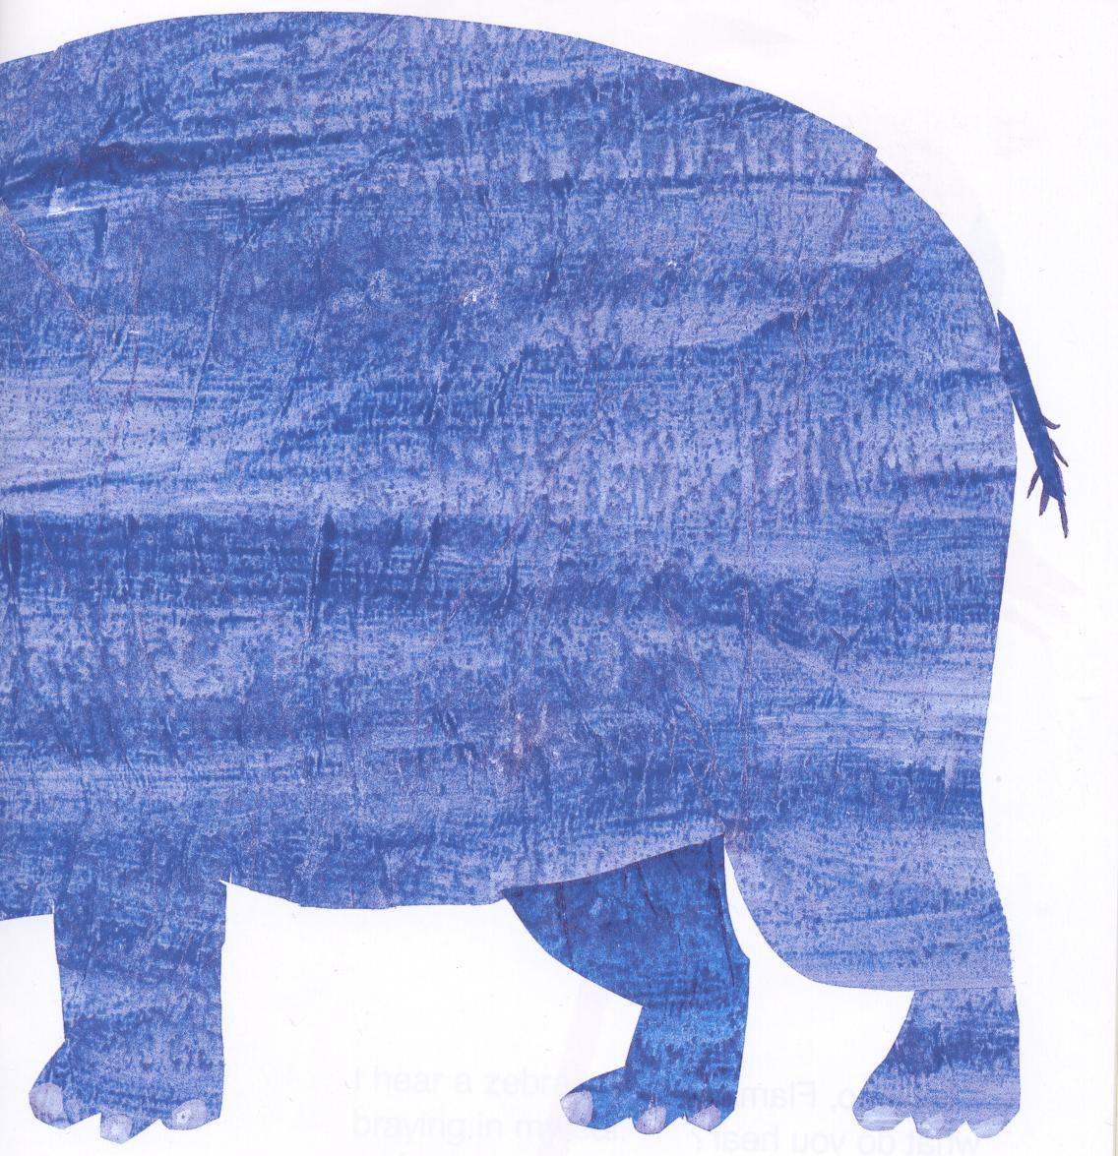
I hear a flamingo
fluting my ear.

Slide 6
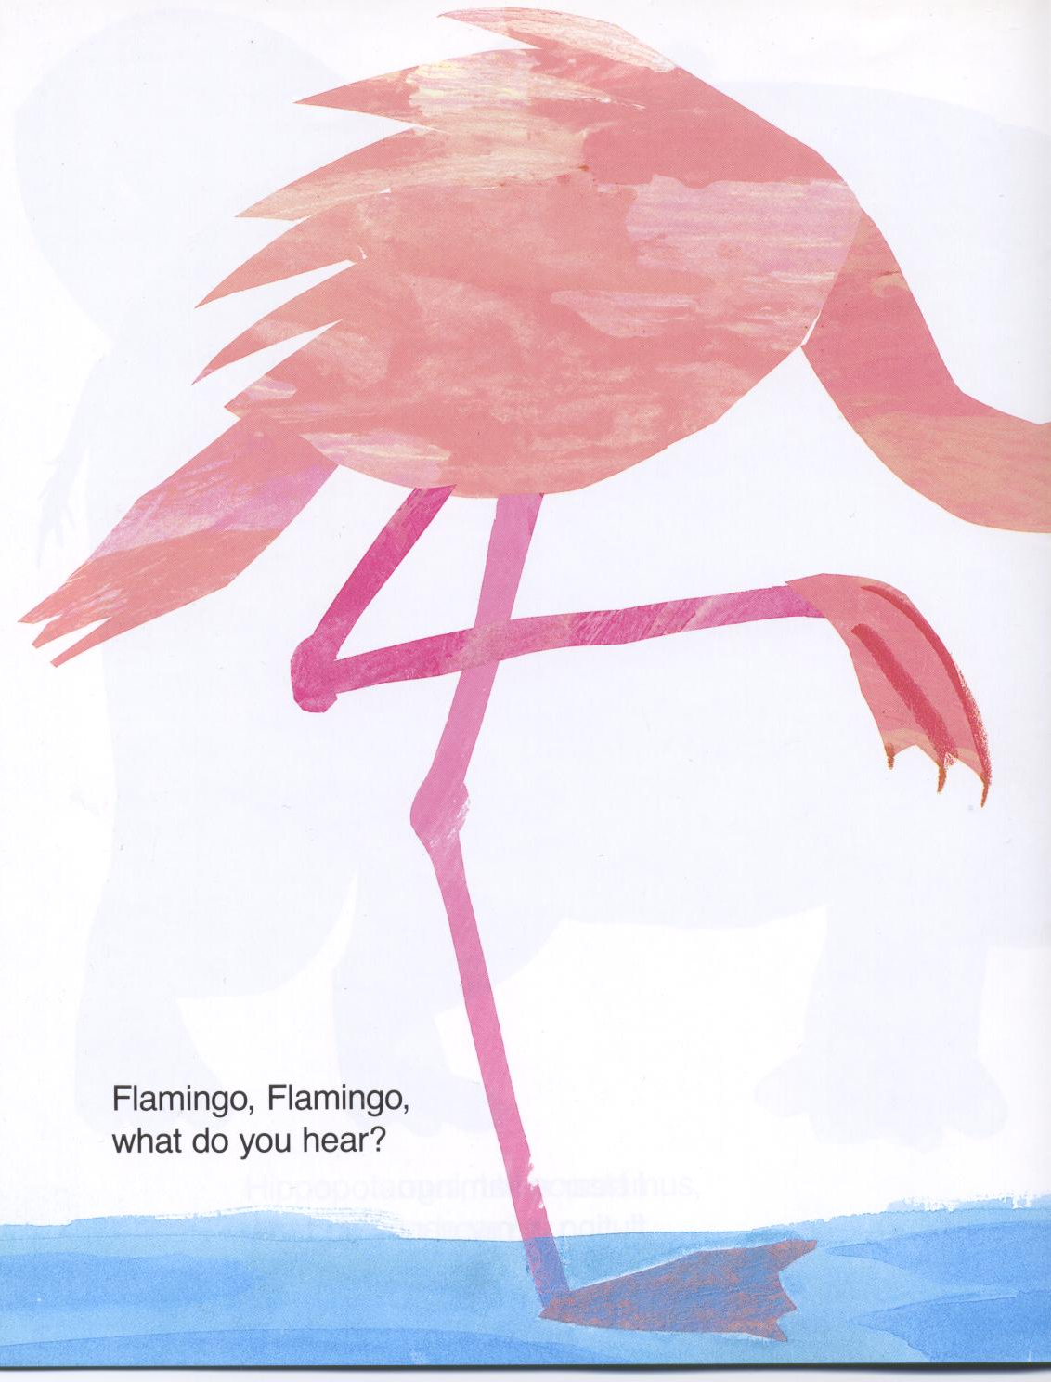
Flamingo, flamingo,
What do you hear?

Slide 7
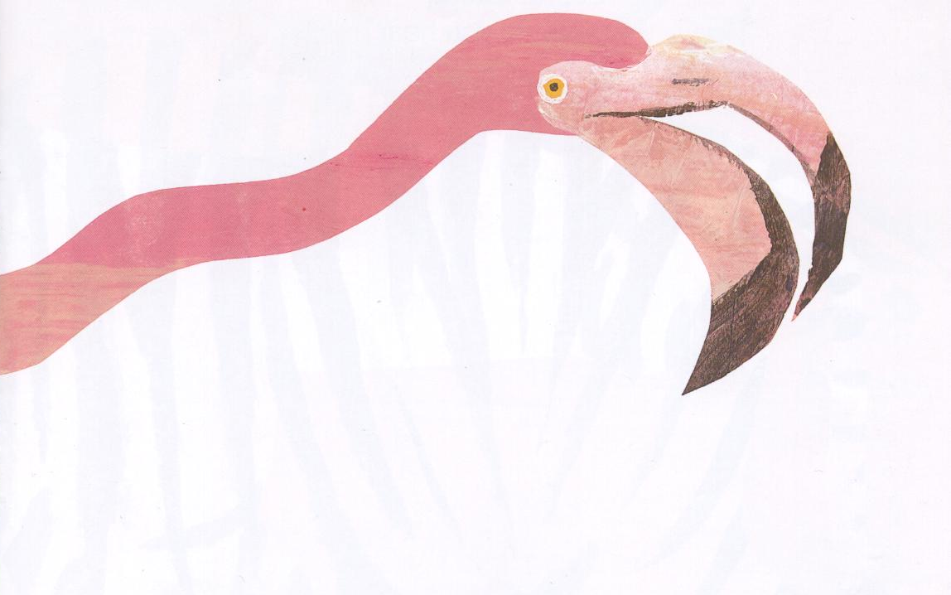
I hear a zebra
braying in my ear.

Slide 8
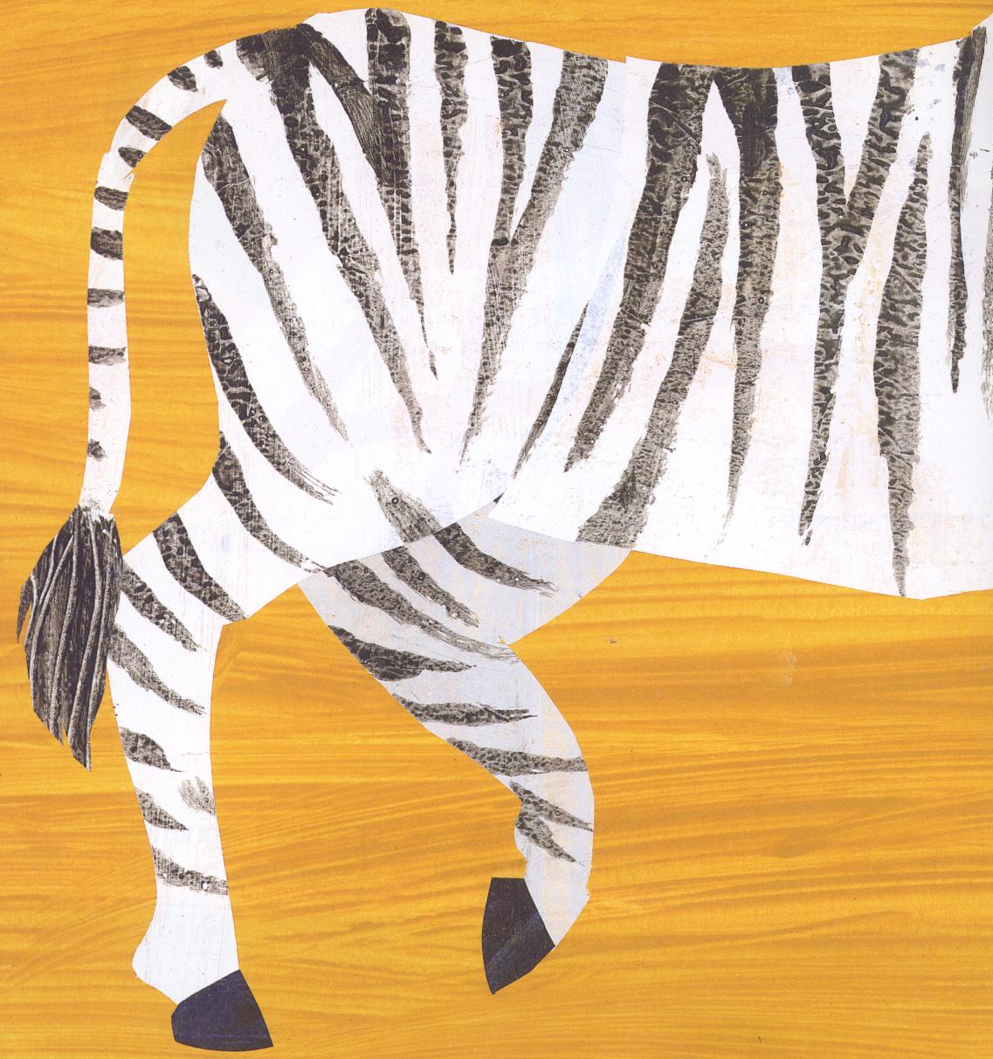
Zebra, zebra
What do you hear?

Slide 9
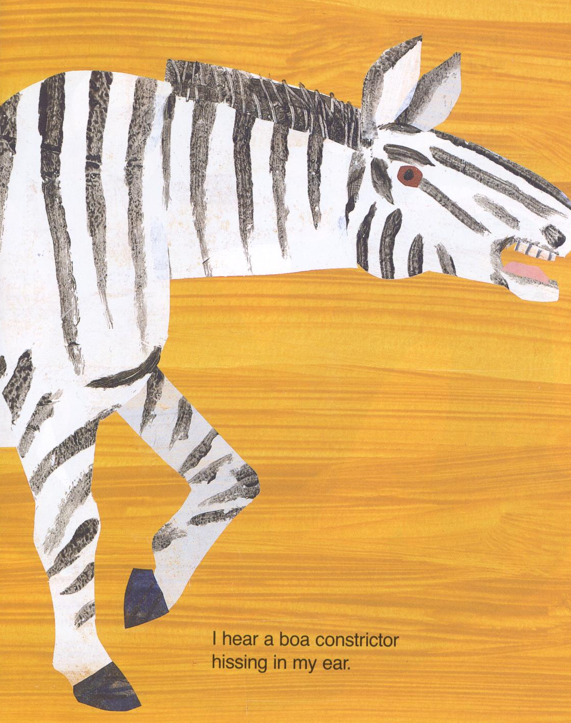
I hear a boa constrictor
hissing in my ear.

Slide 10
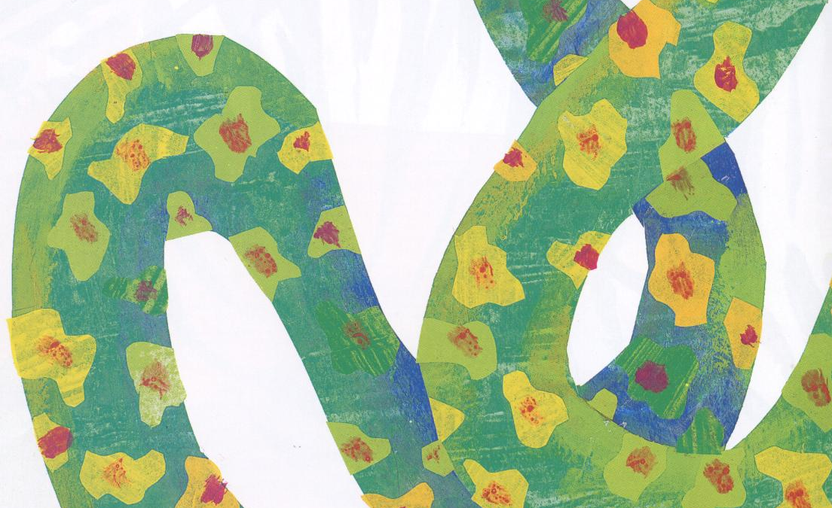
Boa constrictor,
Boa constrictor,
What do you hear?

Slide 11
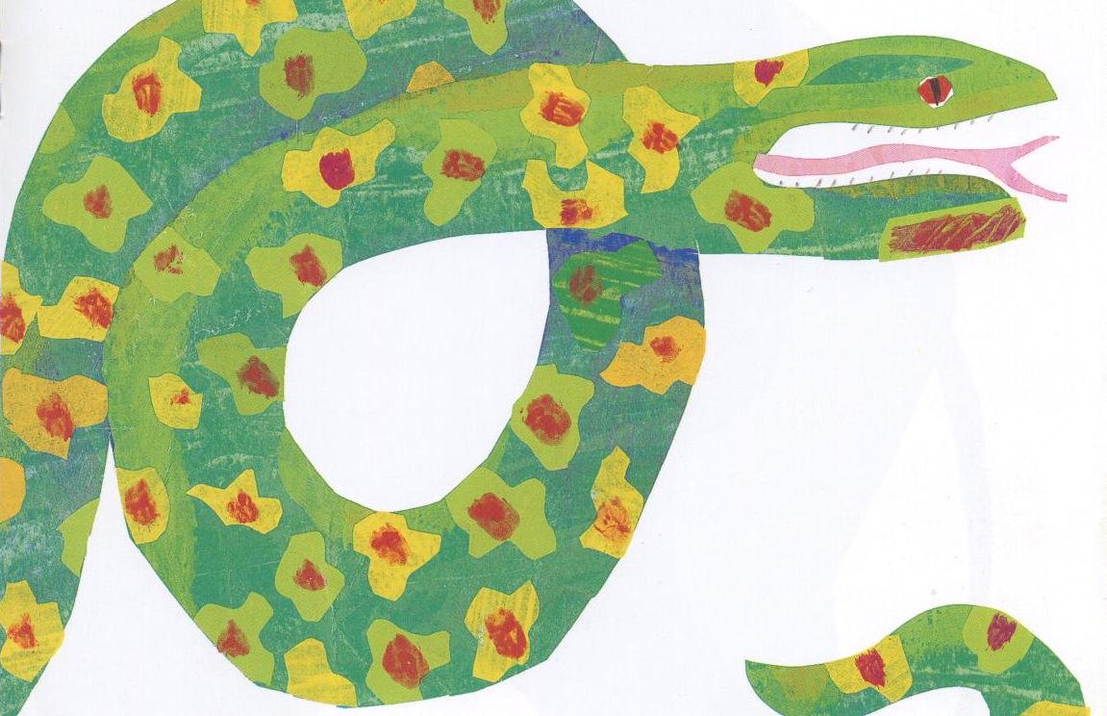
I hear an elephant,
trumpeting in my ear ?

Slide 12
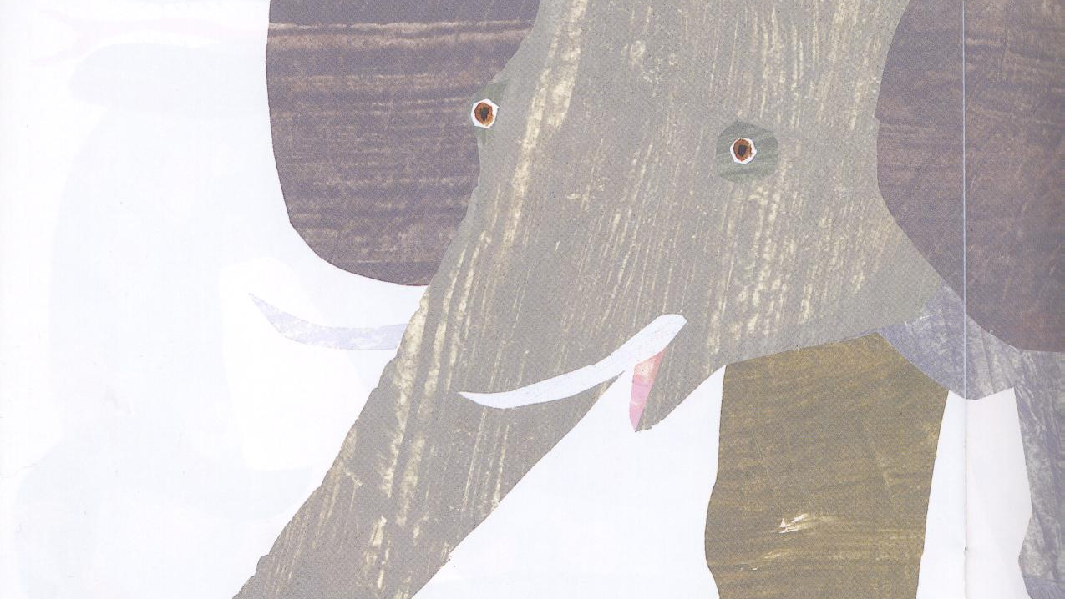
Elephant,
Elephant,
What do you hear?

Slide 13
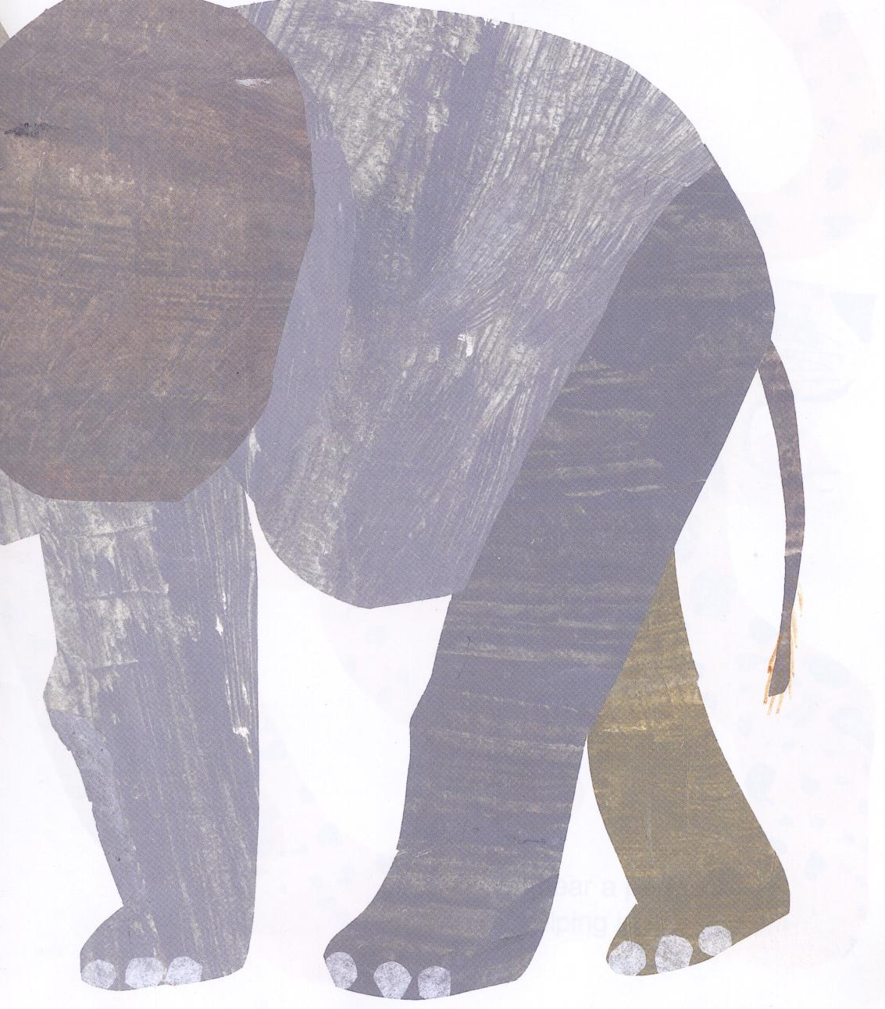
I hear a leopard,
snarling in my ear?

Slide 14
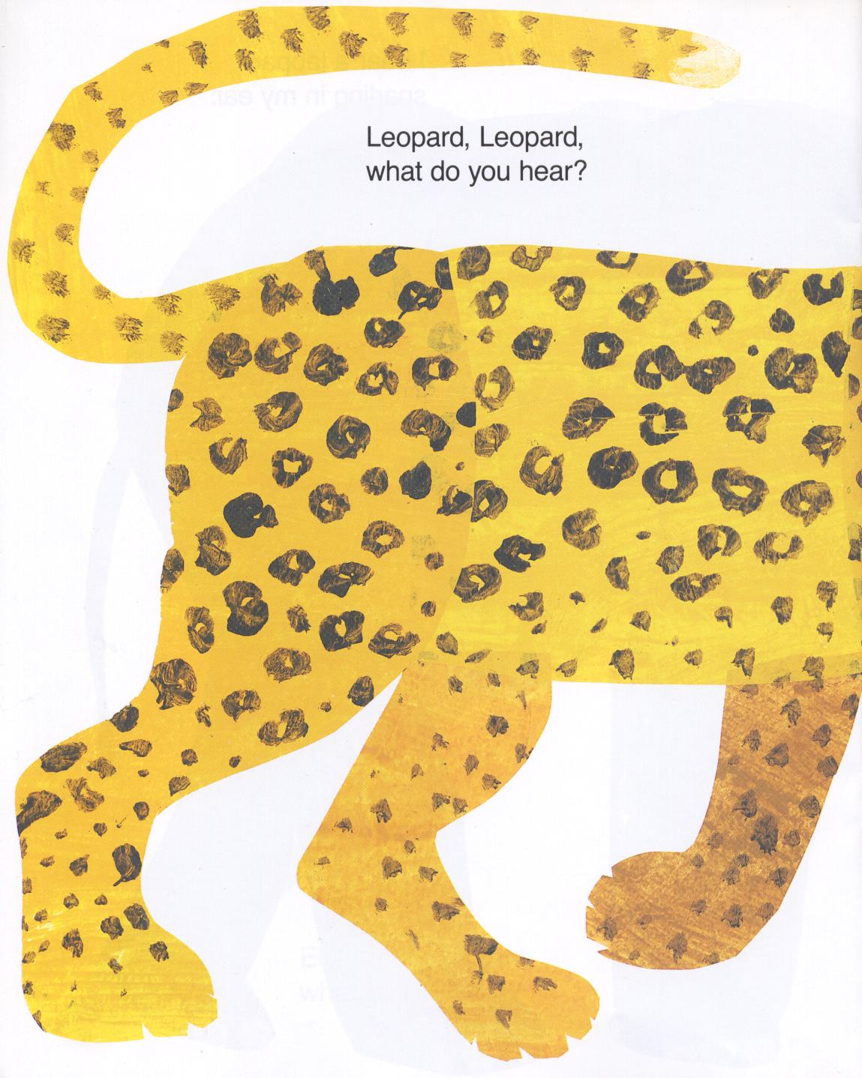
Leopard, leopard,
What do you hear?

Slide 15
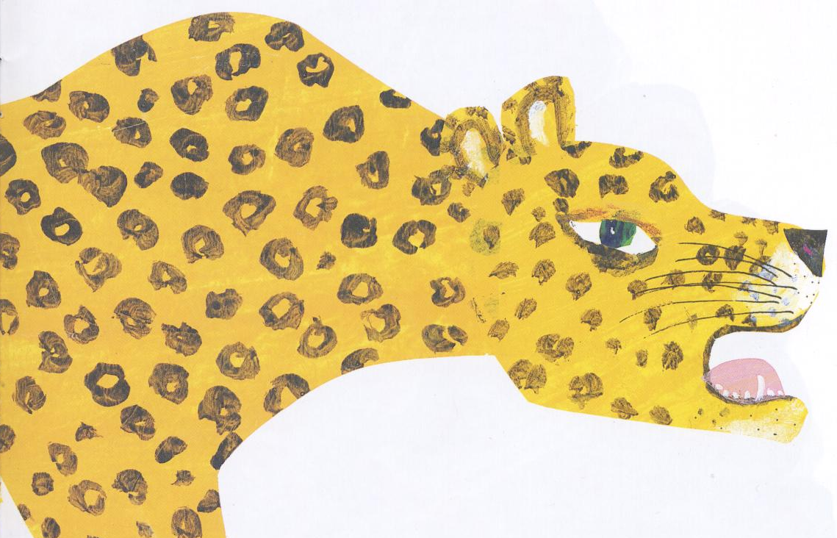
I hear a peacock,
yelping in my ear?

Slide 16
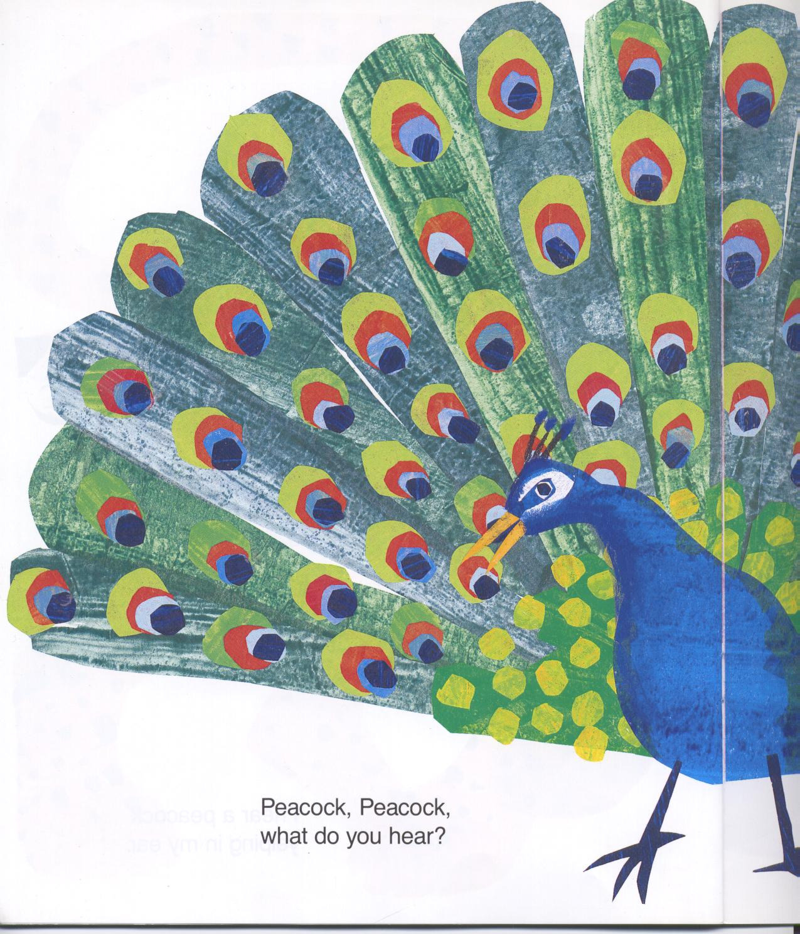
Peacock, peacock,
What do you hear?

Slide 17
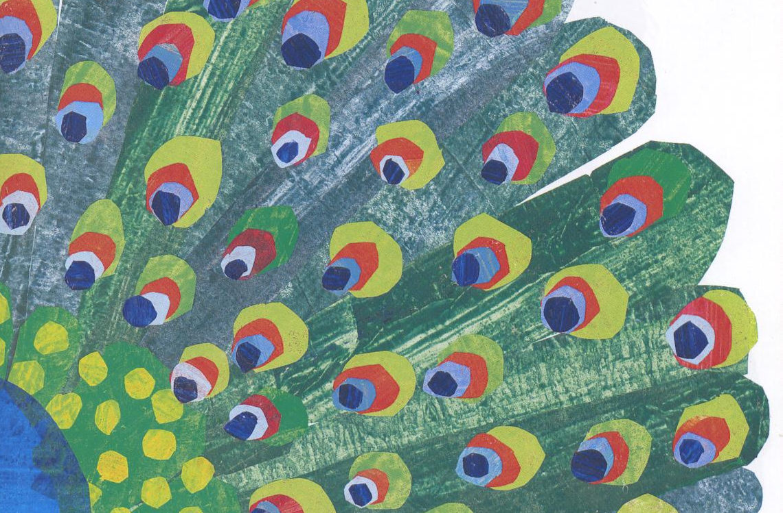
I hear a walrus,
Bellowing in my ear.

Slide 18
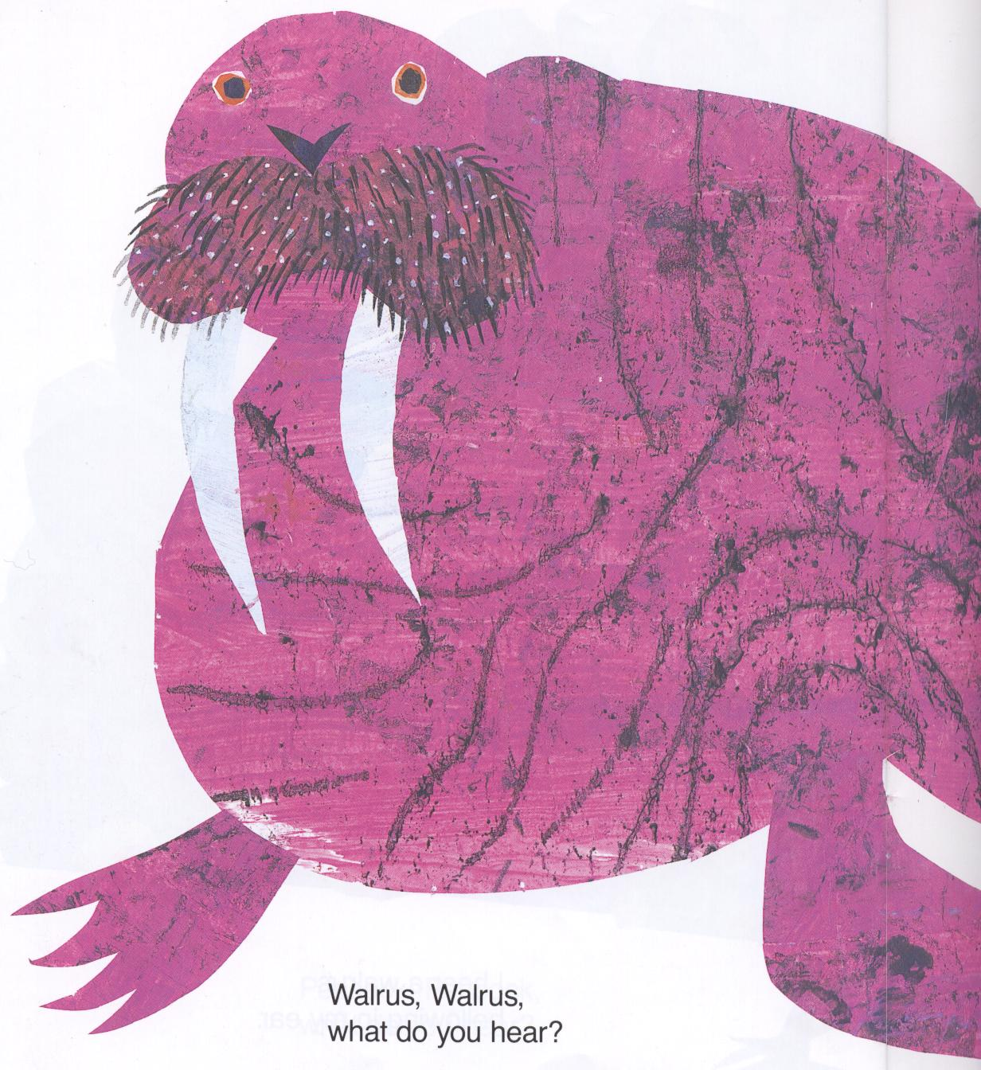
Walrus, walrus,
What do you hear?

Slide 19
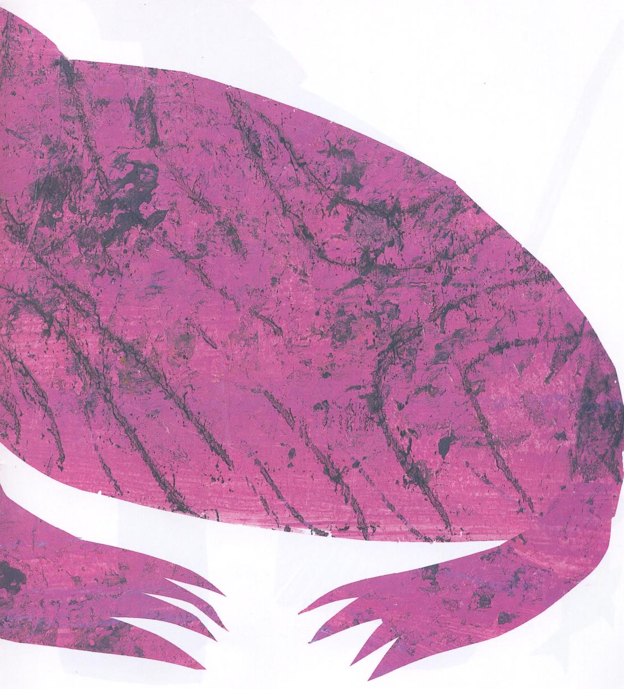
I hear a zookeeper,
whistling in my ear.

Slide 20
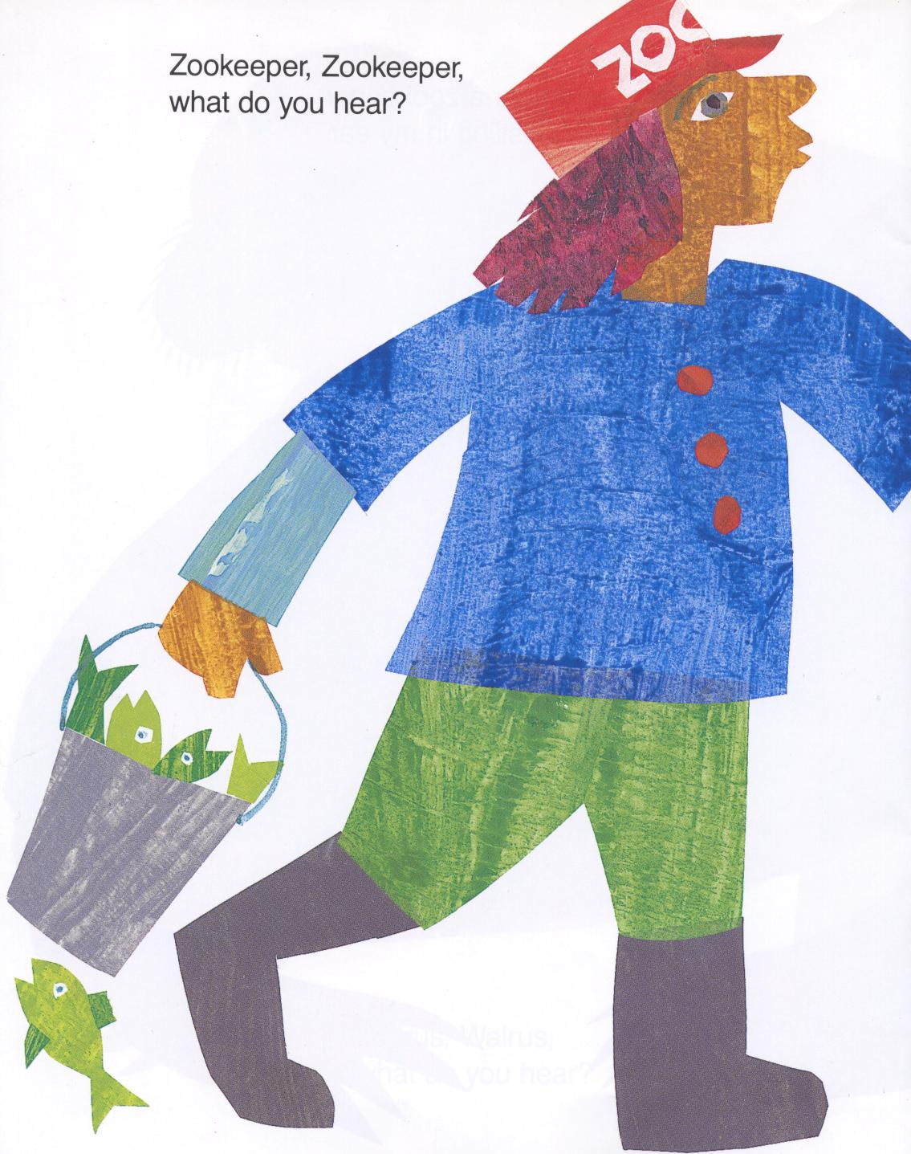
Zookeeper, zookeeper
What do you hear?

Slide 21
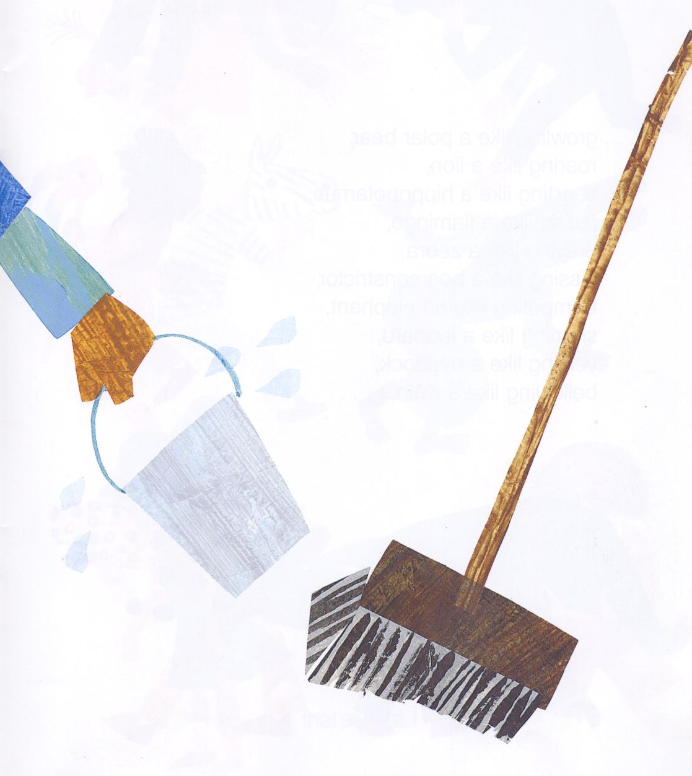
I hear children …

Slide 22
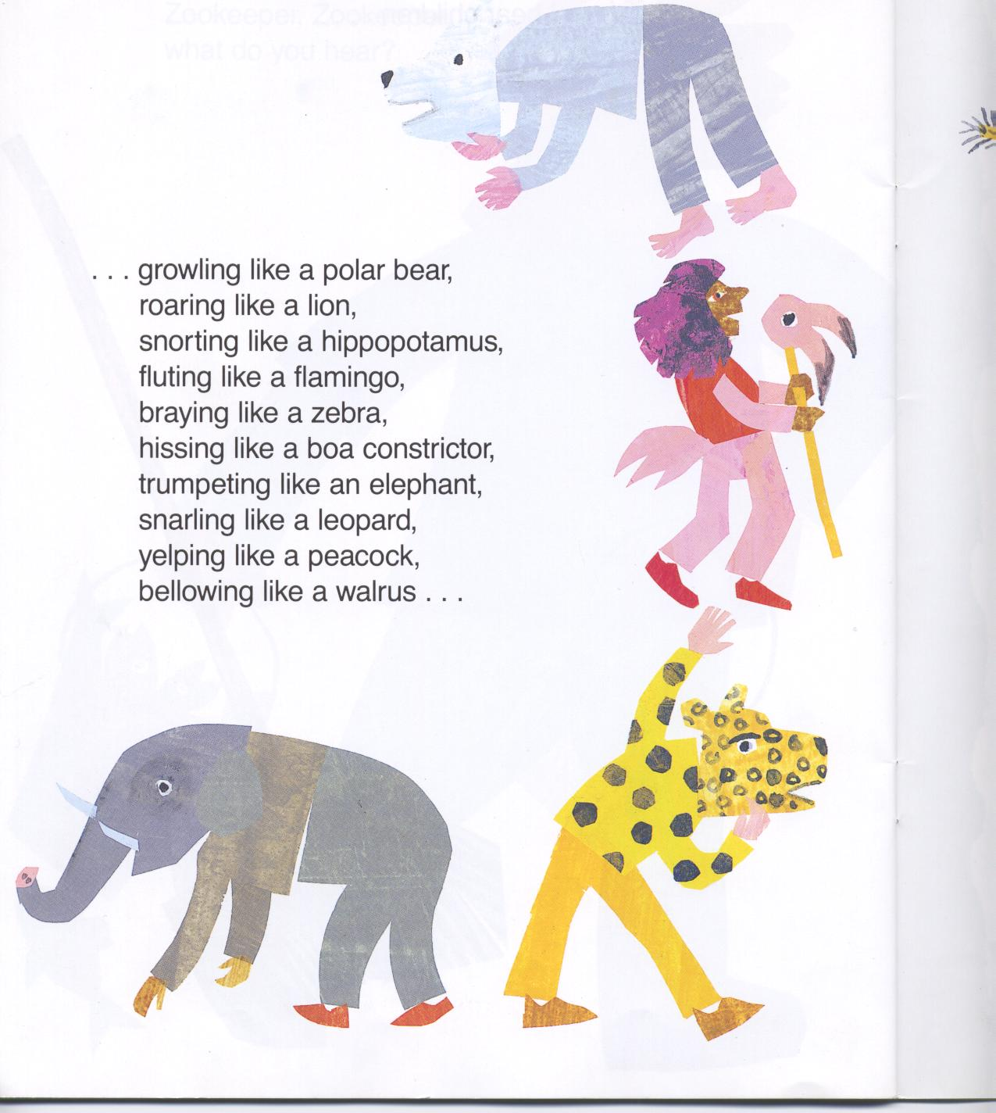
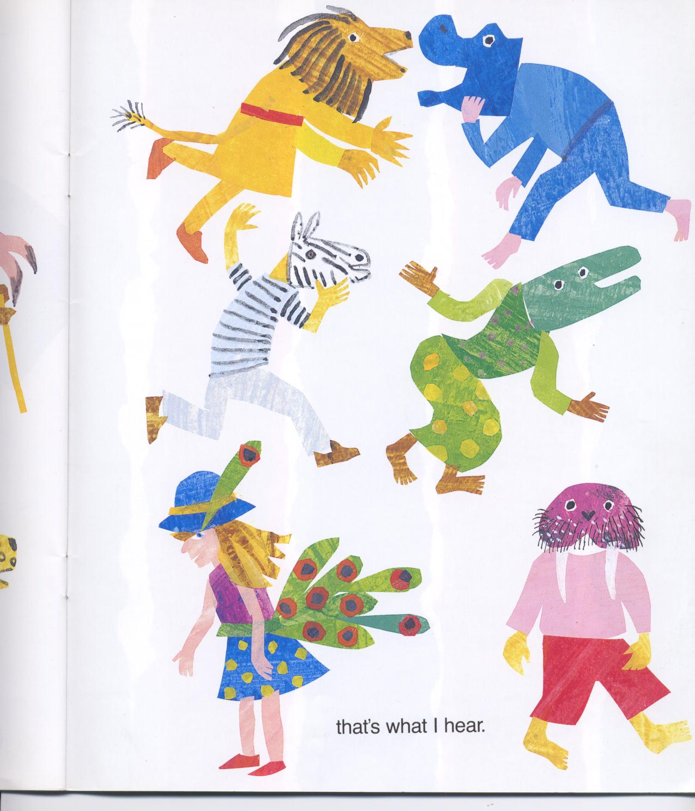
Growling like a polar bear.
Roaring like a lion.
Snorting like a hippopotamus.

Slide 23
Fluting like a flamingo.
Braying like a zebra.
Hissing like a boa constrictor.
Trumpeting like an elephant.

Slide 24
Snarling like a leopard.
Yelping like a peacock.
Bellowing like a walrus.

